Slide 1
Data Visualization Project -1 US unemployment rate
Sonia Baee
October 2016

Slide 2
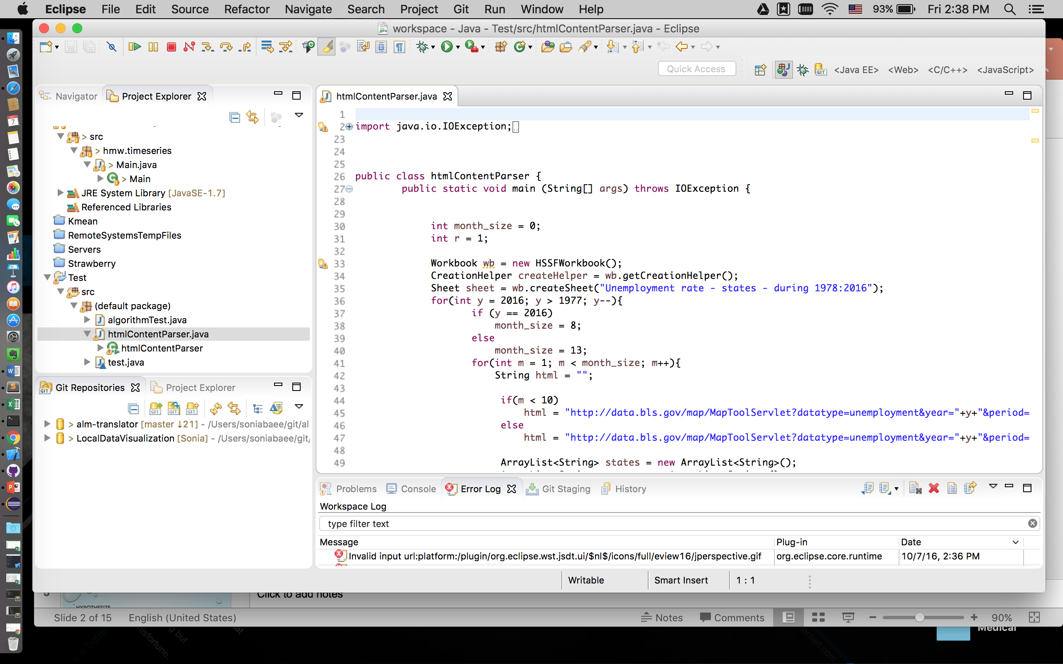
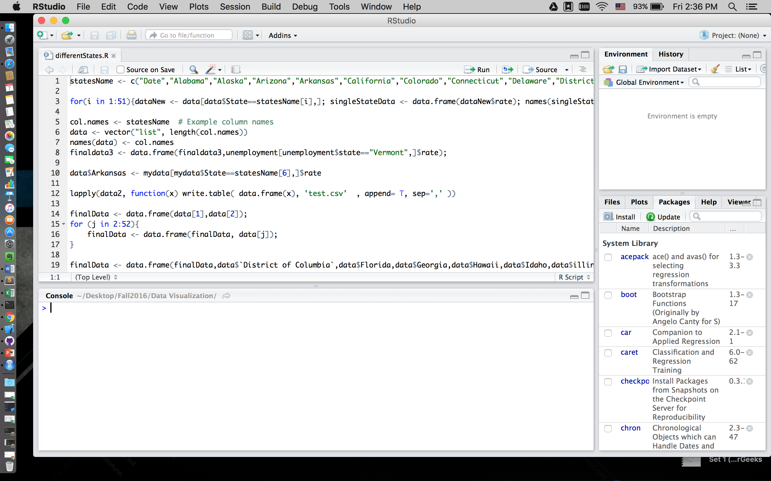
My application
Data processing
https://sonia2016.github.io

Slide 3
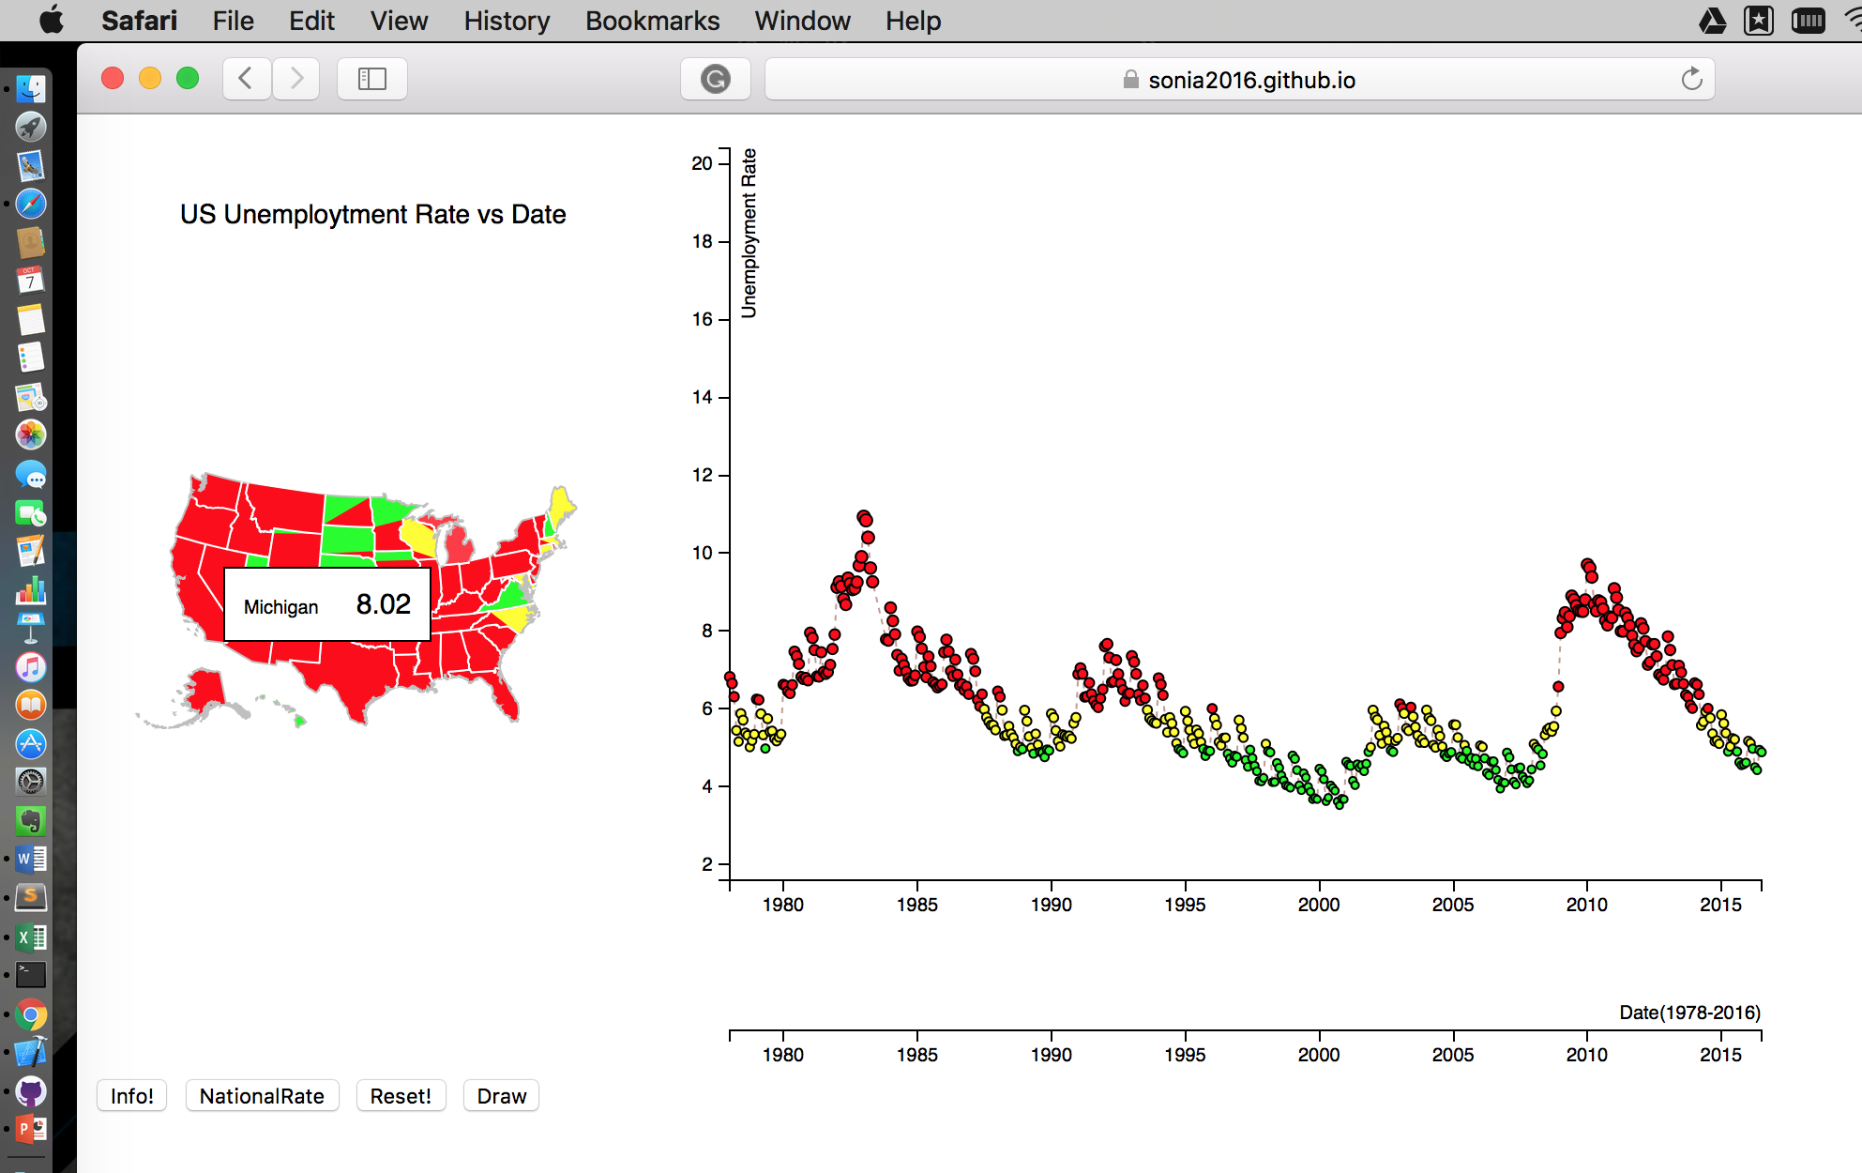
Hypothesize
The relationship between criminal activity and the unemployment rate.
We can hypothesize that higher unemployment leads to higher crime rates.
The judgement is supported by the fact that the cities in the United States with the highest crime rates all have a population below poverty rate higher than the U.S. average of 15.1%. Detroit has the highest reported violent crime rate of 2,072/100,000 people, with 38.1% of their population living below the poverty line.

Slide 4
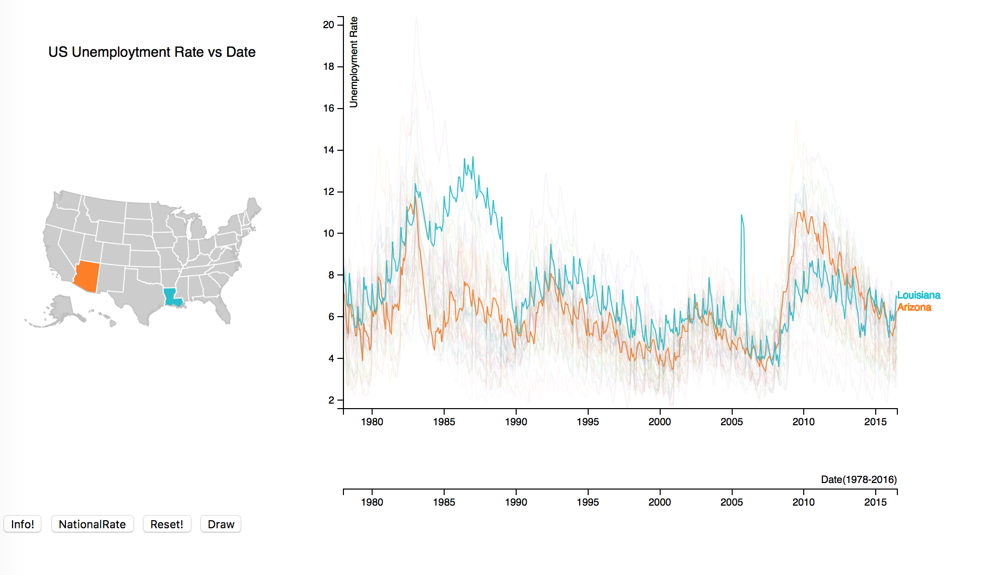
Hypothesize
Louisiana sudden drop
Because of oil and gas industry
Arizona sudden drop
was led by increased government hiring.
As the tourist season continues, leisure and hospitality employment climbed by 5,900 new employees. Other sectors gained modestly with professional and business services adding 2,000 positions. Construction, too, was up for the second month in a row, but just adding 100 jobs. Manufacturing added 1,300 jobs and financial activities each gained 1,600 jobs. Close to 200 of those were with the new Springleaf Financial offices opening in Tempe.
Job losses came in the natural resource and mining sector, and trade, transportation and utilities, which dropped 100 and 500 jobs, respectively.

Slide 5
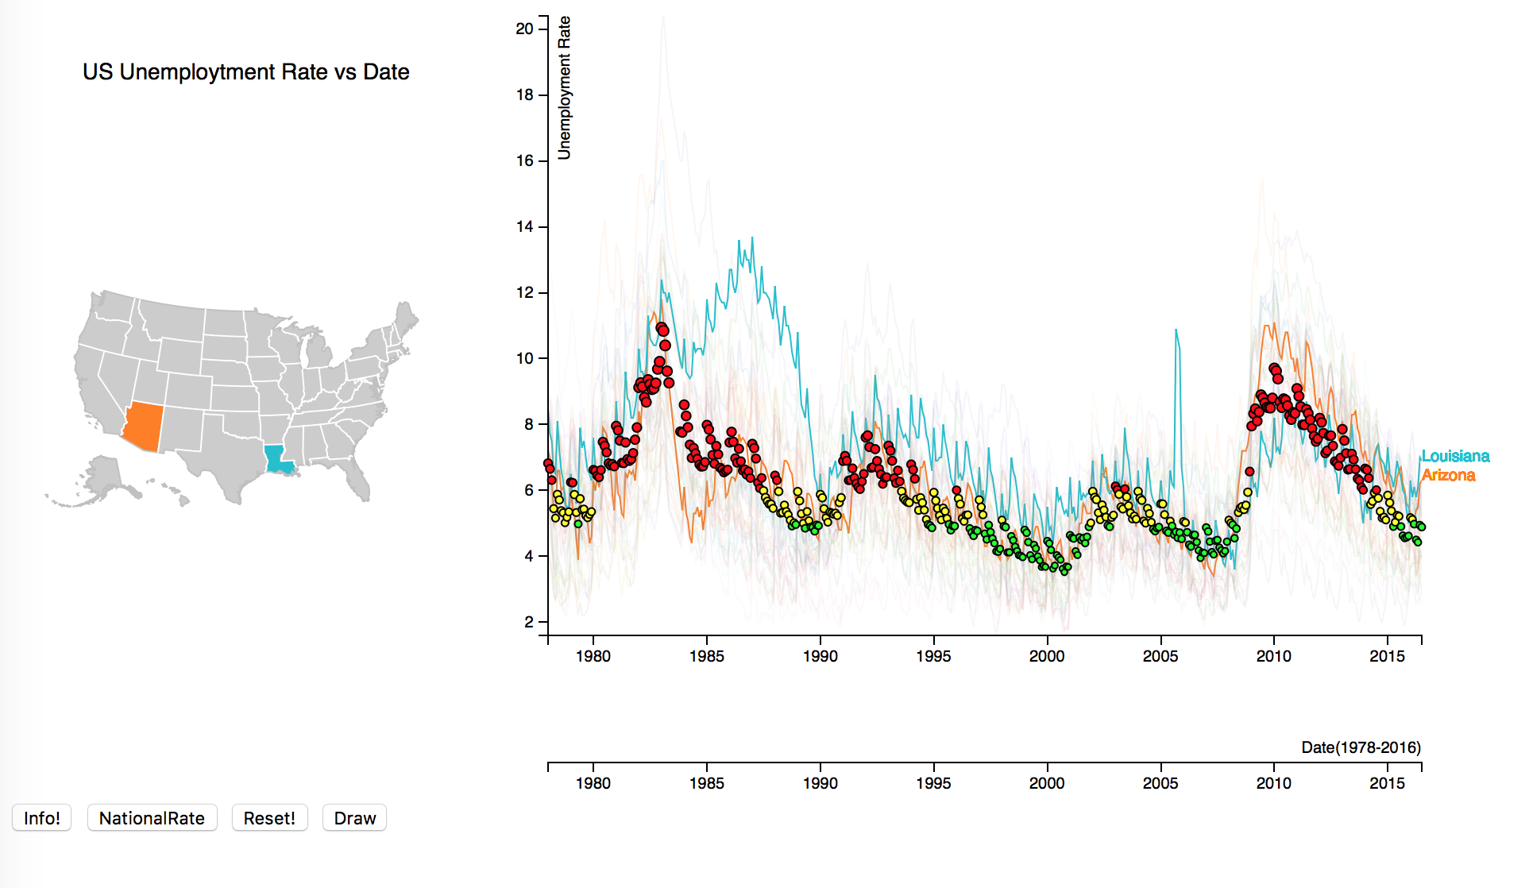
Hypothesize
The reason that unemployment and inflation was falling together in the 1990s and later is because underemployment was rising.
(of a person) not having enough paid work or not doing work that makes full use of their skills and abilities.

Slide 6
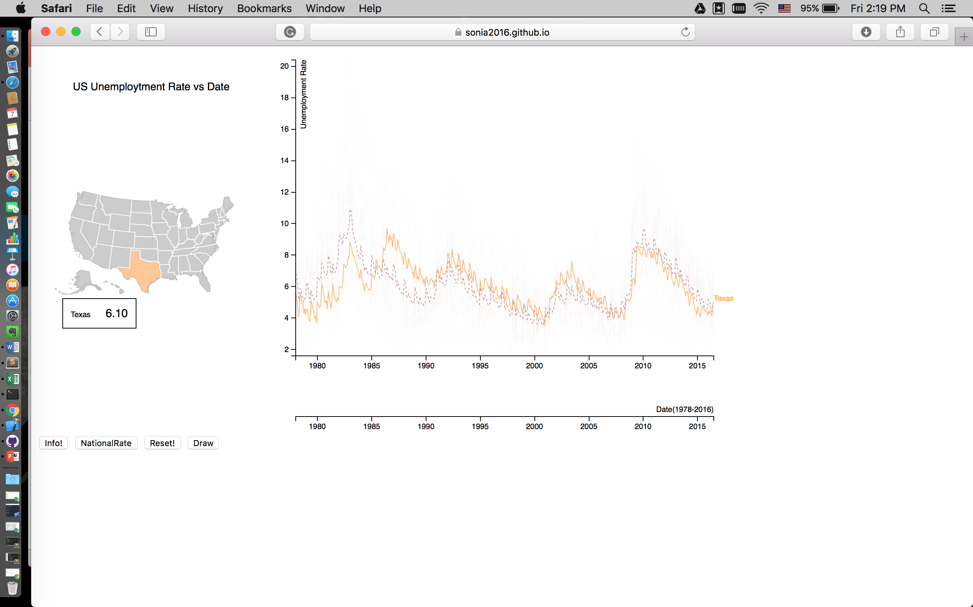
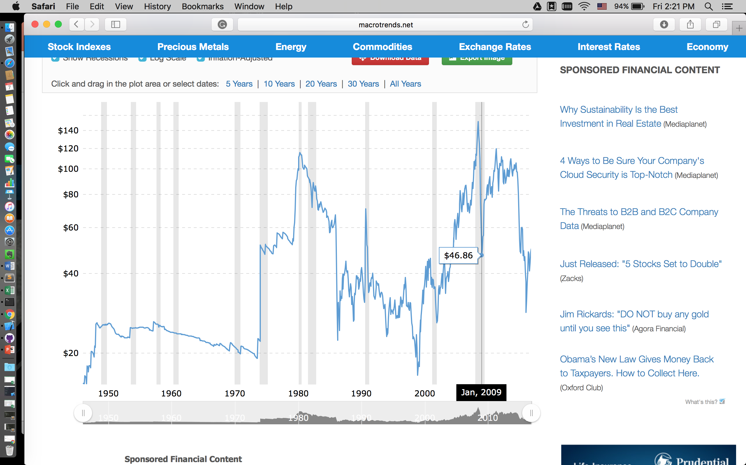
Hypothesize
Texas
Highest rate → lowest oil price
2009 the lower oil price

Slide 7
BLS report
What should the public pay attention to in the BLS report? Furchtgott-Roth points to seven different measures, including:

Slide 8
BLS report
What should the public pay attention to in the BLS report? Furchtgott-Roth points to seven different measures, including:
The labor force participation rate: A decline in the unemployment rate can take place when Americans leave the labor force, as those who have given up on work are not included in unemployment numbers. Similarly, the unemployment rate can rise if more Americans resume their job searches. One must look at the participation rate in order to understand what a drop in the unemployment rate really indicates.

Slide 9
BLS report
What should the public pay attention to in the BLS report? Furchtgott-Roth points to seven different measures, including:
The labor force participation rate: A decline in the unemployment rate can take place when Americans leave the labor force, as those who have given up on work are not included in unemployment numbers. Similarly, the unemployment rate can rise if more Americans resume their job searches. One must look at the participation rate in order to understand what a drop in the unemployment rate really indicates.
The U-6 unemployment rate: There are six different measures of unemployment, the most common being the U-3 rate. The U-3 rate does not count discouraged workers or part-timers who wish to be full-time as unemployed, but the U-6 rate does. In July, the U-6 rate was 12.2 percent, far above the official unemployment rate of 6.2 percent.

Slide 10
BLS report
What should the public pay attention to in the BLS report? Furchtgott-Roth points to seven different measures, including:
The labor force participation rate: A decline in the unemployment rate can take place when Americans leave the labor force, as those who have given up on work are not included in unemployment numbers. Similarly, the unemployment rate can rise if more Americans resume their job searches. One must look at the participation rate in order to understand what a drop in the unemployment rate really indicates.
The U-6 unemployment rate: There are six different measures of unemployment, the most common being the U-3 rate. The U-3 rate does not count discouraged workers or part-timers who wish to be full-time as unemployed, but the U-6 rate does. In July, the U-6 rate was 12.2 percent, far above the official unemployment rate of 6.2 percent.
Revised jobs numbers from previous months: The BLS will revise its previous job creation numbers for June and July when it issues its report. Notably, the jobs numbers issued for August will also be revised in subsequent months.

Slide 11
BLS report
What should the public pay attention to in the BLS report? Furchtgott-Roth points to seven different measures, including:
The labor force participation rate: A decline in the unemployment rate can take place when Americans leave the labor force, as those who have given up on work are not included in unemployment numbers. Similarly, the unemployment rate can rise if more Americans resume their job searches. One must look at the participation rate in order to understand what a drop in the unemployment rate really indicates.
The U-6 unemployment rate: There are six different measures of unemployment, the most common being the U-3 rate. The U-3 rate does not count discouraged workers or part-timers who wish to be full-time as unemployed, but the U-6 rate does. In July, the U-6 rate was 12.2 percent, far above the official unemployment rate of 6.2 percent.
Revised jobs numbers from previous months: The BLS will revise its previous job creation numbers for June and July when it issues its report. Notably, the jobs numbers issued for August will also be revised in subsequent months.
Total hours worked: Are Americans working more or less hours each week? Last month, the number of hours worked rose. This number can be affected by policies like Obamacare, which incentivizes employers to move workers to part-time jobs.

Slide 12
BLS report
What should the public pay attention to in the BLS report? Furchtgott-Roth points to seven different measures, including:
The labor force participation rate: A decline in the unemployment rate can take place when Americans leave the labor force, as those who have given up on work are not included in unemployment numbers. Similarly, the unemployment rate can rise if more Americans resume their job searches. One must look at the participation rate in order to understand what a drop in the unemployment rate really indicates.
The U-6 unemployment rate: There are six different measures of unemployment, the most common being the U-3 rate. The U-3 rate does not count discouraged workers or part-timers who wish to be full-time as unemployed, but the U-6 rate does. In July, the U-6 rate was 12.2 percent, far above the official unemployment rate of 6.2 percent.
Revised jobs numbers from previous months: The BLS will revise its previous job creation numbers for June and July when it issues its report. Notably, the jobs numbers issued for August will also be revised in subsequent months.
Total hours worked: Are Americans working more or less hours each week? Last month, the number of hours worked rose. This number can be affected by policies like Obamacare, which incentivizes employers to move workers to part-time jobs.
The teenage unemployment rate: Teenagers are employed in low-skilled positions, so when the teenage unemployment rate rises, it can have a lasting impact on low-skilled workers, whose lack of experience can leave them locked out of the job market.

Slide 13
BLS report
What should the public pay attention to in the BLS report? Furchtgott-Roth points to seven different measures, including:
The labor force participation rate: A decline in the unemployment rate can take place when Americans leave the labor force, as those who have given up on work are not included in unemployment numbers. Similarly, the unemployment rate can rise if more Americans resume their job searches. One must look at the participation rate in order to understand what a drop in the unemployment rate really indicates.
The U-6 unemployment rate: There are six different measures of unemployment, the most common being the U-3 rate. The U-3 rate does not count discouraged workers or part-timers who wish to be full-time as unemployed, but the U-6 rate does. In July, the U-6 rate was 12.2 percent, far above the official unemployment rate of 6.2 percent.
Revised jobs numbers from previous months: The BLS will revise its previous job creation numbers for June and July when it issues its report. Notably, the jobs numbers issued for August will also be revised in subsequent months.
Total hours worked: Are Americans working more or less hours each week? Last month, the number of hours worked rose. This number can be affected by policies like Obamacare, which incentivizes employers to move workers to part-time jobs.
The teenage unemployment rate: Teenagers are employed in low-skilled positions, so when the teenage unemployment rate rises, it can have a lasting impact on low-skilled workers, whose lack of experience can leave them locked out of the job market.
Long-term unemployment: Long-term unemployment means unemployment for at least 27 weeks. That number was at 32.9 percent in July, meaning one-third of the unemployed had been out of work for almost seven months. The longer a person is out of the job market, the more difficult it is for him to re-enter it.

Slide 14
References
http://www.bls.gov/opub/mlr/2015/beyond-bls/lower-oil-prices-texas-and-the-national-economy.htm
http://bilbo.economicoutlook.net/blog/?p=25577
https://smartech.gatech.edu/bitstream/handle/1853/53294/theeffectsofunemploymentoncimerates.pdf

